Slide 1





IMAGE AUTHENTICATION AND TAMPER DETECTION USING STEGANOGRAPHY APPROACH
GROUP : 15
MENTOR: Ms. Sudipta Roy
DEPARTMENT: Information Technology
(2019-2023)
Made By :-
Arindam Goswami (11500219015)
Priyanshu Kashyap (11500219037)
Anushka Gupta (11500219038)
Rishabh Kumar Chaudhary(11500219047)

Slide 2
Table Of Contents
Proposed Work
Literature review
Overview and Introduction
Future Scope
Watermarking Algorithm
Conclusion
Extraction Algorithm
References
Tampering Detection Algorithm
Result Analysis

Slide 3
Proposed Work
Watermarking & Tampering
Tampering Detection

Slide 4
Objective
Security
Visual Quality Preservation
High Embedding Capacity
Practical Applicability

Slide 5
Overview
Digital Watermark
The Original Image
Embed
Watermark Image
Encryption Algorithm
Attack
Watermark Tampering Detection
Post-attack Image
Extract watermark

Slide 6
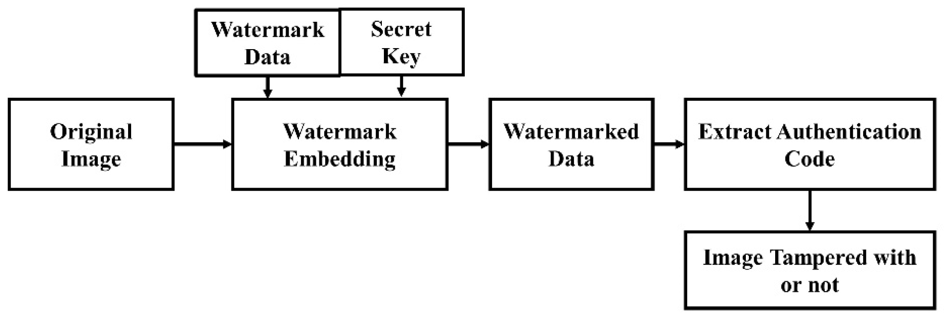
Introduction
— In the field of digital image processing, ensuring the security and integrity of images has become increasingly important. One approach to address this concern is the embedding of a secret image within a cover image using techniques such as Discrete Cosine Transform (DCT) and Pseudo-Noise (PN) sequences. This research focuses on the process of embedding a 32x32 bitmap (.bmp) image into a 512x512 cover image, as well as the subsequent extraction process involving tampering detection and noise analysis.

Slide 7
Watermarking
Image digital watermarking is a technique used to watermark hidden information or a digital signature within a digital image. There are two main types of digital watermarks: visible and invisible. Visible watermarks are usually overlaid on top of the image and are easily visible, often consisting of text or a logo. They are commonly used to indicate ownership or copyright information.
Visible Watermarking
Invisible Watermarking
Spatial Domain Watermarking
Frequency Domain Watermarking

Slide 8
Types of Image Tampering
Image Manipulation Techniques
Cropping and Resizing
Copy-Move
Techniques
Image Forgery Techniques
Splicing
Cloning
Object Removal
Text and Logo Insertion
Image Noise Addition

Slide 9
Noise
In image detection techniques, "noise" refers to unwanted and random variations or disturbances that can occur in an image. It can obscure the underlying information and affect the accuracy and quality of image analysis, recognition, or processing algorithms. Noise can be introduced during image acquisition, transmission, or storage processes.
Gaussian Noise
Poisson Noise
Quantization Noise
Salt and Pepper Noise
Speckle Noise

Slide 10
Performance Metrics
Image Quality Assessment (IQA) is a field of study that aims to measure the perceived quality of images. IQA plays a crucial role in various applications, including multimedia systems, image compression, and computer vision. This could be analyzed by using following metrices:
MSME
PSNR
SSI
CC

Slide 11
Literature Review
Deepika Sharma , Pawanesh Abrol discusses in paper [1] that the ability to transmit digital images using imaging technologies like digital cameras, scanners, photo-editing, and software packages has significantly increased over the past few years as a result of significant advancements
Detection techniques, according to Minati Mishra and Flt. Lt. Dr. M. C. Adhikary [2] ,is primarily based on Both active and passive tamper detection methods have been the subject of much research, and there is still much work being done globally to effectively detect tampering in digital photographs.
Arshad Jamal, Mohammed Hazim Alkawaz , Mariam-Aisha Fatima, Mohd Shukri Ab Yajid ,in paper[3]. In the area of digital image processing, a variety of watermarking techniques and algorithms are available.
Rajkumar Ramasamy and Vasuki Arumugam, ”Digital watermarking —A tutorial” in IEEE Conference[4]. In this article, they've covered a range of topics related to digital watermarking, such as its concepts, prerequisites, different domains with fundamental algorithms.

Slide 12
Watermarking Algorithm
Convert the original
RGB images to
YCbCr color space.
Extract the Y-channel
from the
YCbCr images.
Generate a
pseudo-random
PN sequence
using a security key.
Permute the
Y-channel using
the PN sequence.
Divide the permuted
Y-channel into 8x8
non-overlapping blocks.
Apply Discrete
Cosine Transform
(DCT) to each block.
Select 1024 random
blocks to the watermark pixel
Apply Inverse DCT
and combine
the blocks
Remove
the permutation.
Combine the YCbCr channels
to form the RGB watermarked image.

Slide 13
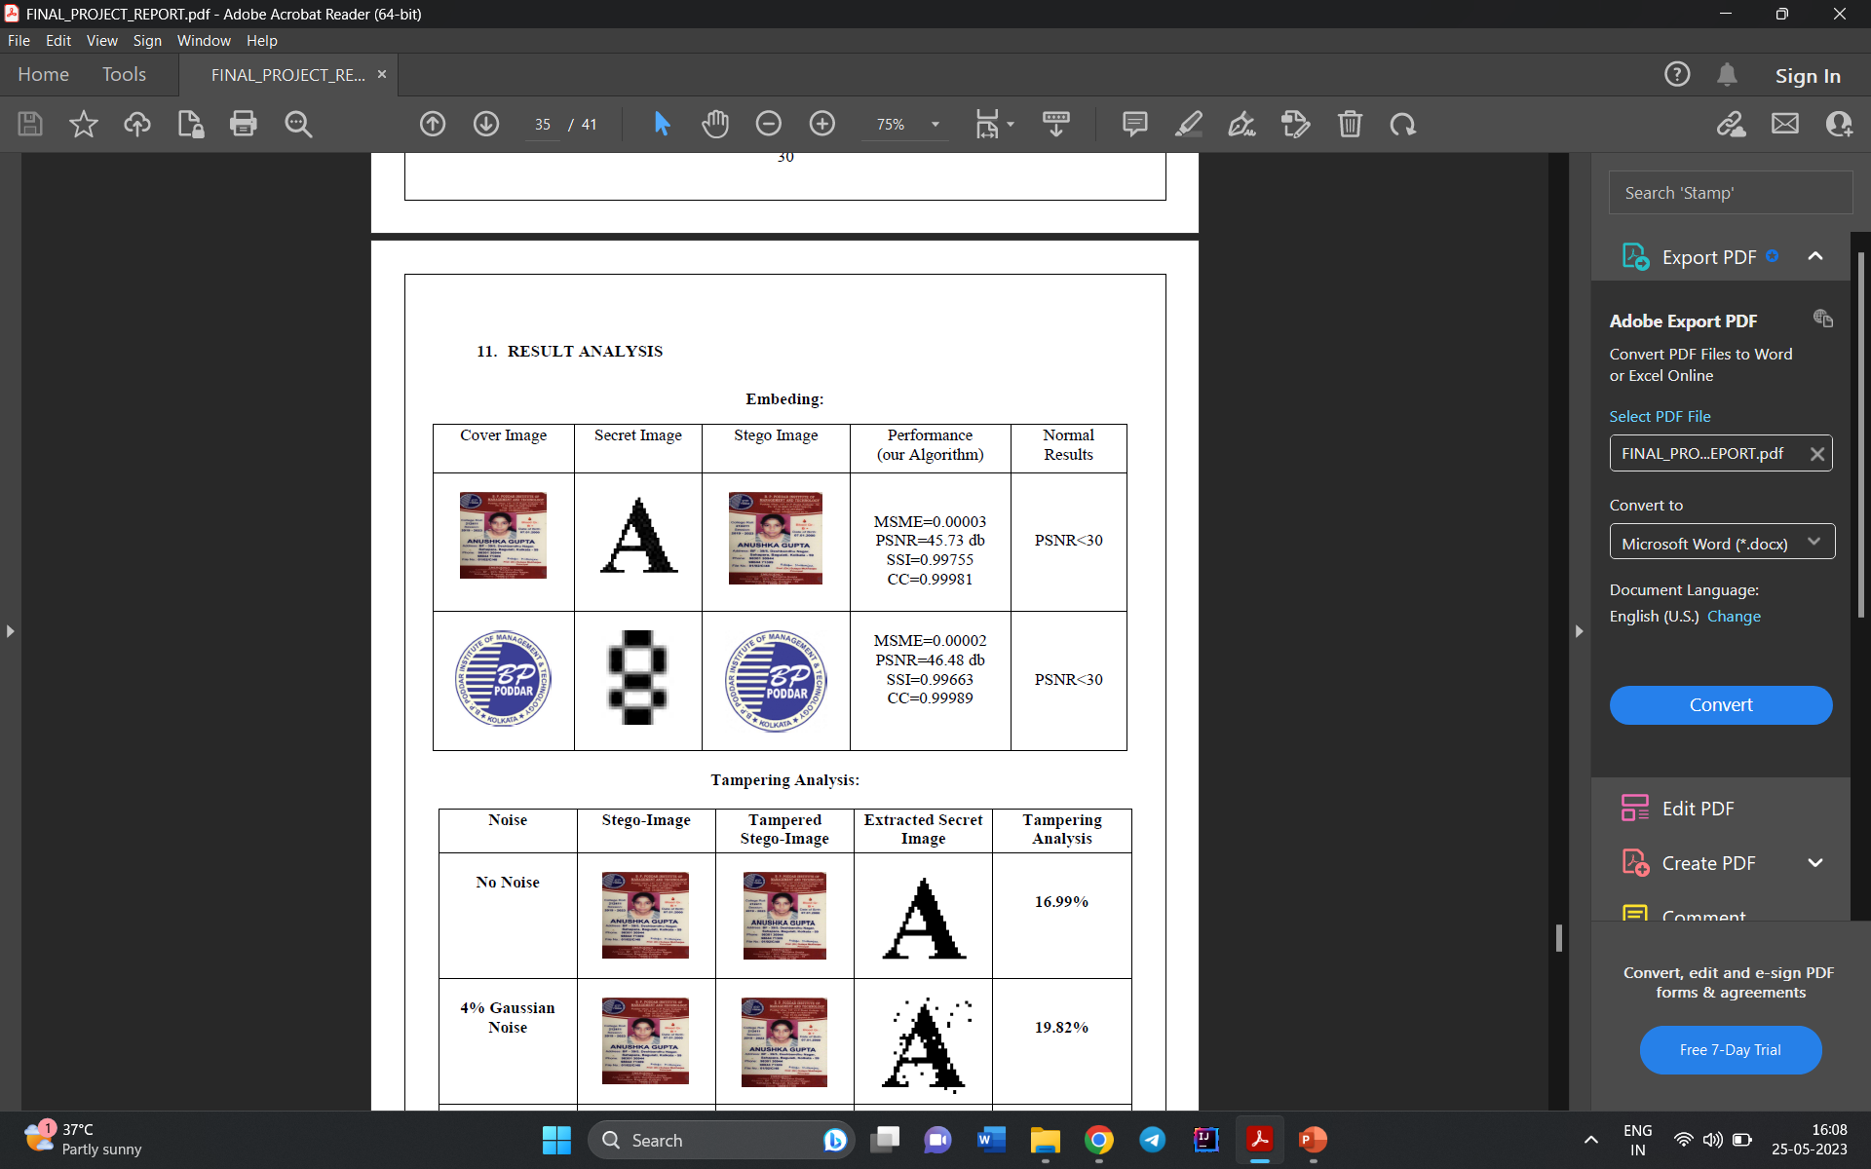
Result Analysis

Slide 14
Comparison Table
Research group | Title | Technique Used | Input | Visual - Imperceptibility
Vaidya et al. | A robust semi-blind watermarking for color images based on multiple decompositions | DWT-CT-Schur-SVD Discrete Wavelet Transform (DWT) | Cover: 512 x 512 Watermark: 64 x 64 | PSNR= Range[27.63- 36.16] dB
Moosaza deh et al. | A new DCT based robust image watermarking method using teaching learning-Based optimization | DCT & TLBO | Cover: 512 x 512 Watermark: 32 x 32 | PSNR= Range[39.95- 40.73] dB
Su et al. | Improved wavelet-based image watermarking through SPIHT | Watermark bits are embedded in the spatial domain on DC coefficients using 2D-DFT. | Cover: 512 x 512 Watermark: 32 x 32 | PSNR= Range[37.62- 38.05] dB
Kumar et al. | Improved wavelet-based image watermarking through SPIHT | DWT + DCT + SVD Set Partitioning in Hierarchical Tree (SPIHT) and Arnold transform for enhancing robustness. | Cover: 512 x 512 Watermark: 32 x 32 | PSNR= Range[25.31- 38.47] dB
Proposed Algorithm | Image Authentication and tamper detection using steganography approach | DCT + PN Sequencing with Key | Cover: 512 x 512 Watermark: 32 x 32 | PSNR= Range[45.55- 50.73] dB

Slide 15
Extraction Algorithm
Convert RGB to YCbCr color-space.
Extract the Y-channel from YCbCr images
Perform the extraction stage &
Compare DCT coefficient
Select a random set of blocks
Calculate the number of blocks
Divide into 8X8 blocks and apply DCT
Reshape into 32X32 Matrix
Return the original
image without the watermark

Slide 16
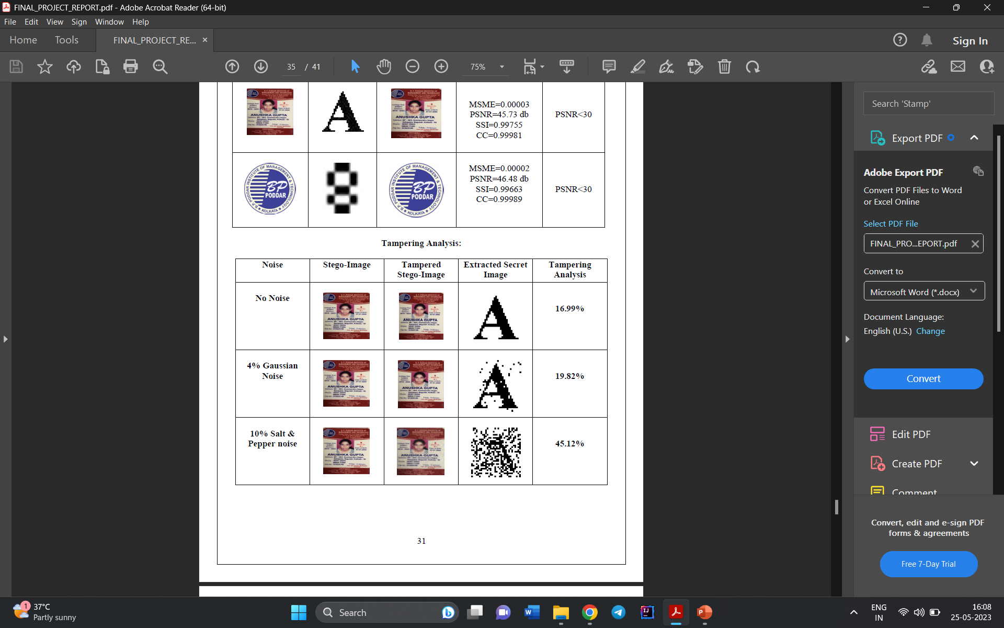
Result Analysis

Slide 17
Tampering Detection Algorithm
Input the Original cover image.
Hide the watermark image in the cover image
Apply tampering on the Stego-image
During transmission, noise is incorporated.
Extract the secret image
Track the difference between similar color pixel byte elements
Compute the average value and similarity aspect
Evaluate the ratios and threshold value

Slide 18
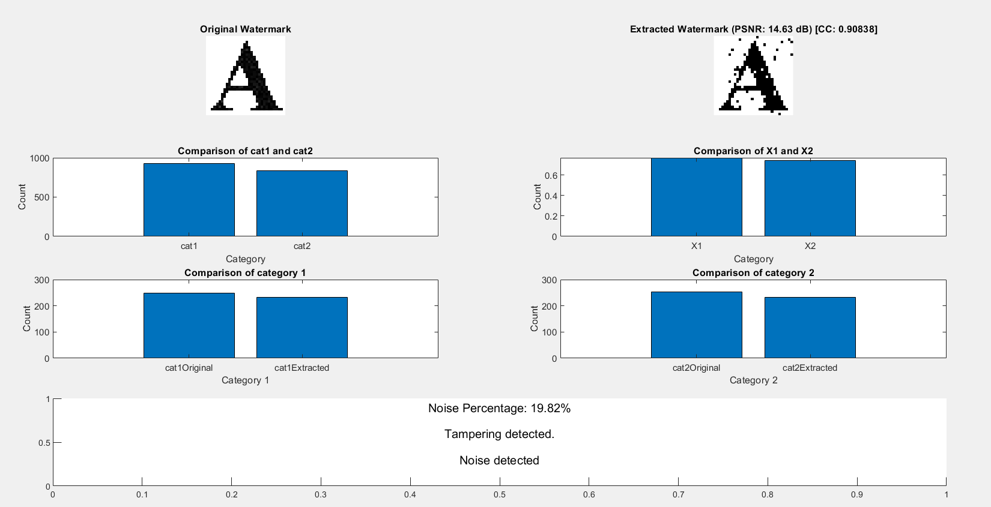
Result Analysis

Slide 19
Future Scope
Only two algorithms have been used to calculate the pixel variations. In future more effective algorithms can be used to attain more accuracy and precision. Such algorithms could more efficiently detect even the smallest of tampering. That means we may be able to detect the position of manual tampering more precisely and the location could be exactly tracked. Also we can use more complex algorithm for encoding and decoding to increase the security and confirm authenticity.

Slide 20
Conclusion
In conclusion, image tampering detection using noise-based analysis holds great potential for Ident identifying and protecting various types of image manipulations. The proposed algorithm, which involves preprocessing, noise extraction, feature extraction, training, testing, tampering localization, and visualization/reporting, provides a framework for robust tampering detection

Slide 21
References
Deepika Sharma et al.,“Digital Image Tampering – A Threat to Security Management”,2013.
Minati Mishra et al., “Digital Image Tamper Detection Techniques - A Comprehensive Study”, 2013.
Arshad et al., “Digital Watermarking” Techniques And its Application Digital Halal Certificate: A Survey”, 2019.
Rajkumar Ramasamy et al., “Digital watermarking —A tutorial” in IEEE Conference,2022.
Vaidya et al., “A robust semi-blind watermarking for color images based on multiple decompositions”, 2017.
Moosazadeh et al., “A new DCT-based robust image watermarking method using teaching-learning-based optimization”, 2019.
Su et al., “New rapid and robust color image watermarking technique in spatial domain”, 2019.
Kumar et al., “Improved wavelet-based image watermarking through SPIHT Multimedia Tools and Applications”, 2020.

Slide 22
Thank You !!!

Slide 23
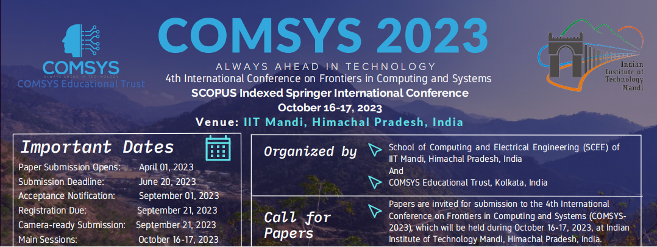
Conference Paper

